Slide 1
Contemplative neuroscience: a brief introduction
David J. Lee, PhD
Department of Public Health Sciences

Slide 2
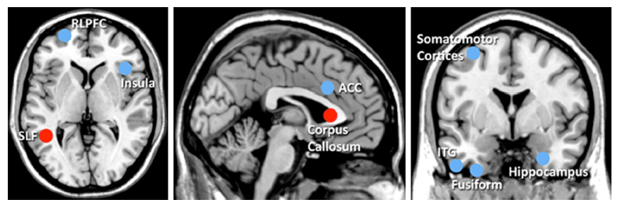
Brain structure differs in meditation practitioners versus non-practitioners
Neuroscience and Biobehavioral Reviews 43 (2014) 48–73
Notes:
Effect size meta-analysis (calculating 132 effect sizes from 16 studies) suggests a global ‘medium’ effect size (Cohen’s ¯d= 0.46; ¯r = .19). Publication bias and methodological limitations are strong concerns, however. Further research using rigorous methods is required to definitively link meditation practice to altered brain morphology.

Slide 3
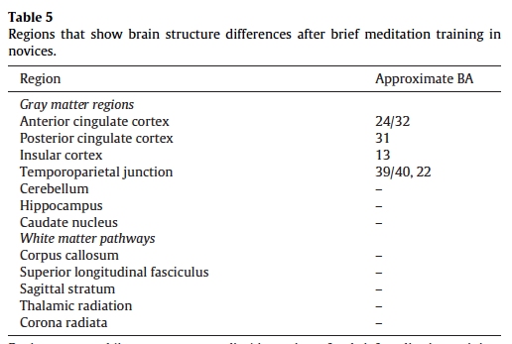
Brief mindfulness training (5-60 hours) alters structure in multiple brain regions
Neuroscience and Biobehavioral Reviews 43 (2014) 48–73
Notes:
Effect size meta-analysis (calculating 132 effect sizes from 16 studies) suggests a global ‘medium’ effect size (Cohen’s ¯d= 0.46; ¯r = .19). Publication bias and methodological limitations are strong concerns, however. Further research using rigorous methods is required to definitively link meditation practice to altered brain morphology.

Slide 4
His Holiness, the 14th Dali Lama, was the impetus for the initial East / West dialog
Spiritual leader of the Tibetan People
Author and co-author of many books
Long-standing interest in the crossroads of science and the world’s spiritual traditions

Slide 5
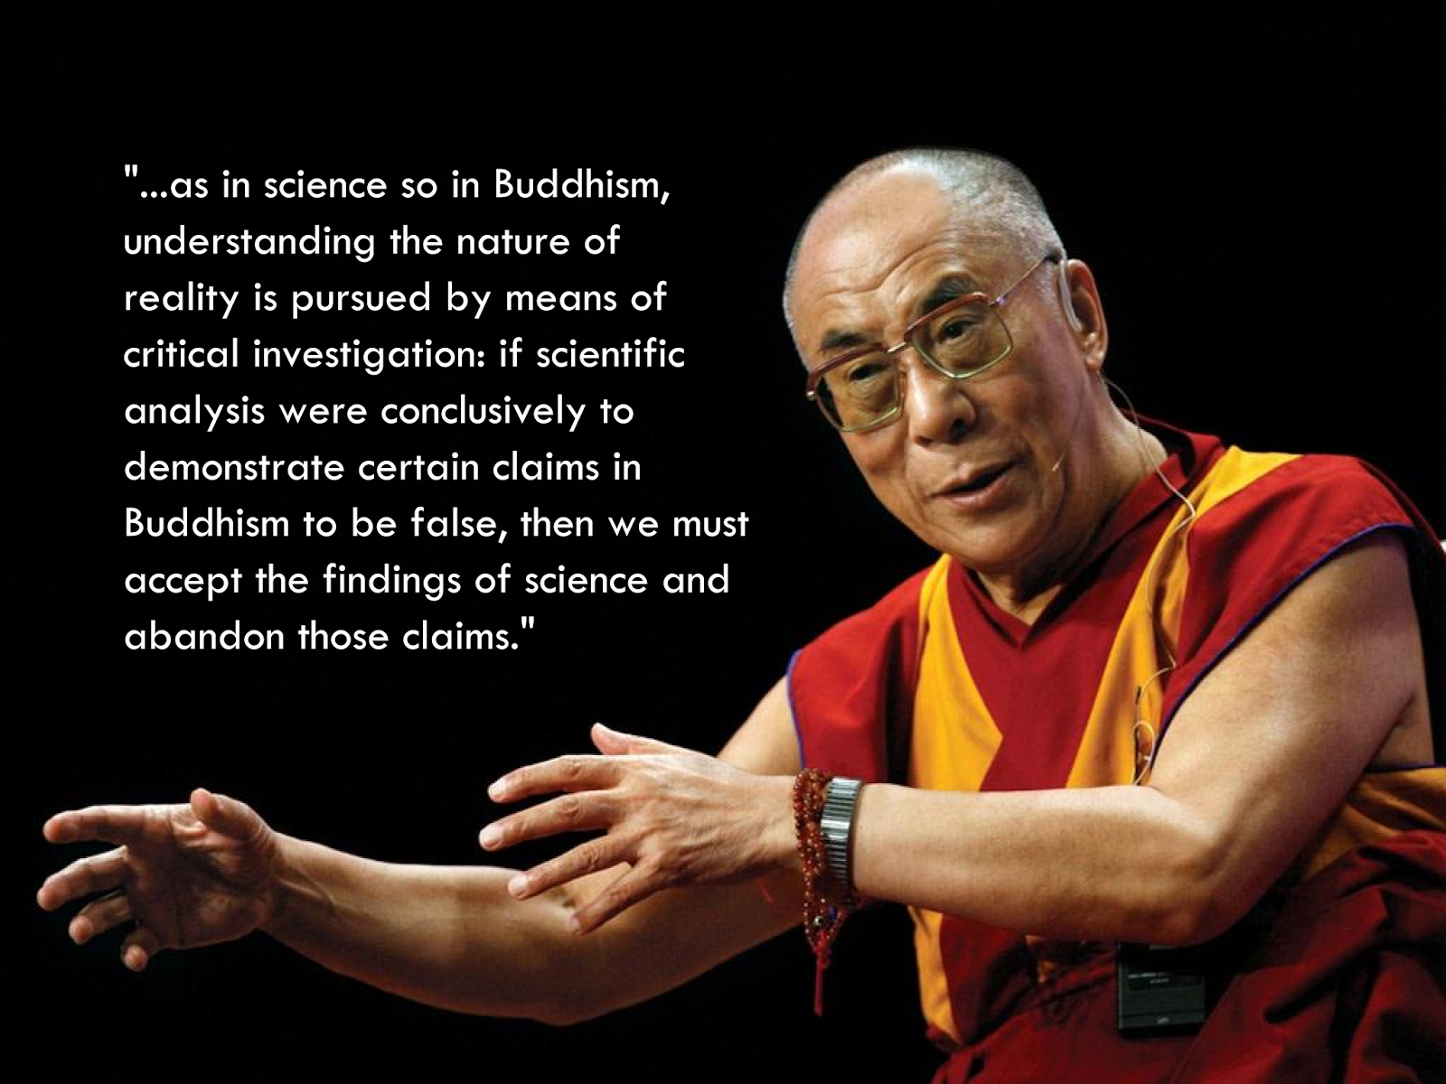
The Dali Lama, has suggested that science can inform the world’s spiritual traditions
The Universe in a Single Atom - The Convergence of Science and Spirituality. Morgan Road books (2005)

Slide 6
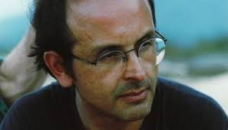
The Dali Lama was first exposed to the field of neuroscience in the 1980’s by Francisco Varela
A Chilean neuroscientist, biologist and philosopher
Became a Tibetan Buddhist in the 1970’s
As a result of ongoing dialog with the Dali Lama went on to co-found the Mind-Life Institute in 1990
Thompson (2015) Waking, Dreaming, Being: Self and Consciousness in Neuroscience, Meditation and Philosophy. Columbia University Press; http://en.wikipedia.org/wiki/Francisco_Varela

Slide 7
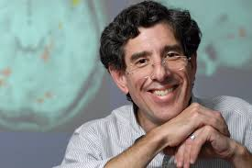
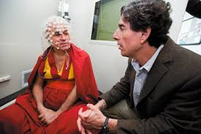
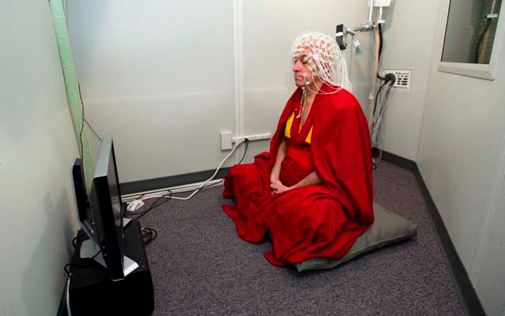
The Mind-Life Institute become the nexus for East-West dialog on the scientific study of mind
In 1998 the Institute expanded their efforts to support Dr. Varela and Dr. Richard Davidson (U Wisconsin-Madison) to conduct pilot studies on long-term meditation practitioners
Could serve as expert ‘first-person’ witnesses to moment-to moment conscious experience
Thompson (2015) Waking, Dreaming, Being: Self and Consciousness in Neuroscience, Meditation and Philosophy. Columbia University Press; http://en.wikipedia.org/wiki/Francisco_Varela

Slide 8
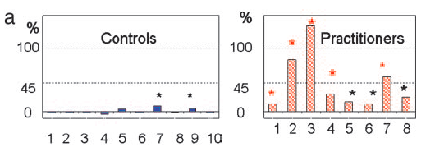
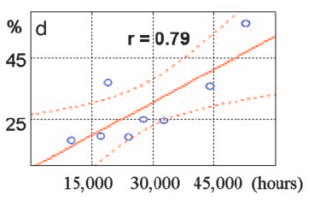
Study documented dramatic EEG gama wave synchrony differences in meditators vs. controls
Compared long-term Buddhist practitioners with controls In 1998 (n=8 & 10)
Practitioners had higher baseline ratio of gamma to slower waves
During meditation practitioners had some of the highest synchronized gamma waves ever recorded in healthy subjects
Levels correlated with # of practice hours
PNAS 2004: 101: 16369-16373

Slide 9
“Pure compassion” meditation aims to suffuse awareness with the affect of compassion
A form of open monitoring or open-awareness meditation
A cultivation of “objectless” awareness –being aware and open to whatever arises in the field of awareness without selecting or preferentially focusing on any particular thing
Open-awareness meditation can lead to an appreciation of the difference between awareness itself– an unobstructed quality of mind– and the changing contents of awareness (thoughts, feelings, emotions)
Ultimately, pure compassion meditation aims to generate the affect of compassion within an open awareness state
Thompson (2015) Waking, Dreaming, Being: Self and Consciousness in Neuroscience, Meditation and Philosophy. Columbia University Press

Slide 10
Loving-Kindness Meditation (LKM) is a related but more structured meditation
Directing caring feelings toward oneself
Then toward loved ones
Then acquaintances
Then strangers
Then someone you have difficulty with
Then all sentient beings (more open awareness)
Journal of Consulting and Clinical Psychology 2014, Vol. 82, No. 6, 1101–1114

Slide 11
LKM research is promising but limited by small, heterogeneous, and poor quality studies
Meta-analyses of 22 studies indicate LKM is moderately effective for:
decreasing self-reported depression ([Hedges’s g]= 0.61)
increasing mindfulness (0.63)
Increasing compassion (0.61)
Increasing self-compassion (0.45)
More study on any potential adverse effects is needed– practice can bring up emotional content
Journal of Consulting and Clinical Psychology 2014, Vol. 82, No. 6, 1101–1114; Germer, C. The Mindful Path to Self-Compassion 2009; Guiliford Press

Slide 12
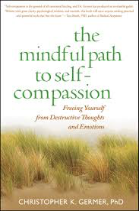
The book by Chris Germer is a good introduction
Journal of Consulting and Clinical Psychology 2014, Vol. 82, No. 6, 1101–1114; Germer, C. The Mindful Path to Self-Compassion 2009; Guiliford Press

Slide 13
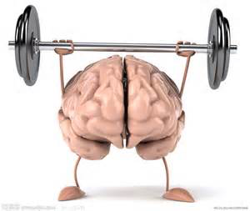
Journal of Consulting and Clinical Psychology 2014, Vol. 82, No. 6, 1101–1114; Germer, C. The Mindful Path to Self-Compassion 2009; Guiliford Press

